Slide 1
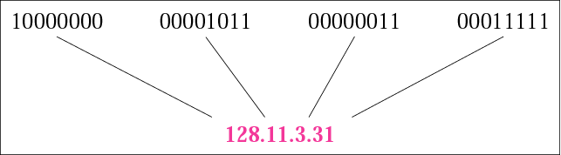
IP Addresses
An IPv4 address is a 32-bit address.
The address space of IPv4 is 2³² or 4,294,967,296.

Slide 2
IP addresses, when started a few decades ago, used the concept of classes. This architecture is called classful addressing. In the mid-1990s, a new architecture, called classless addressing, was introduced and will eventually surpass the original architecture. However, part of the Internet is still using classful addressing, but the migration is very fast.

Slide 3
Classful Addressing

Slide 4
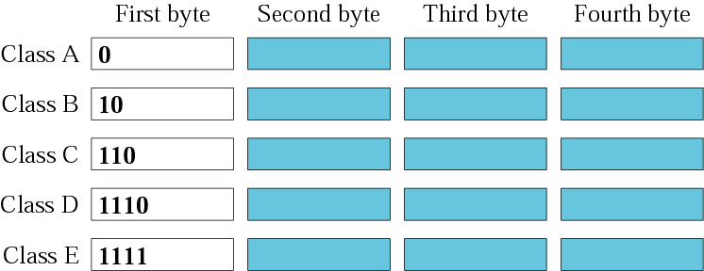
Class A | 0-127 | n/w . Host . Host . Host
Class B | 128-191 | n/w . n/w . Host . Host
Class C | 192-223 | n/w . n/w . n/w . Host
Class D | 224-239 | Multicast addresses
Class E | 240-255 | Reserved for future use

Slide 5
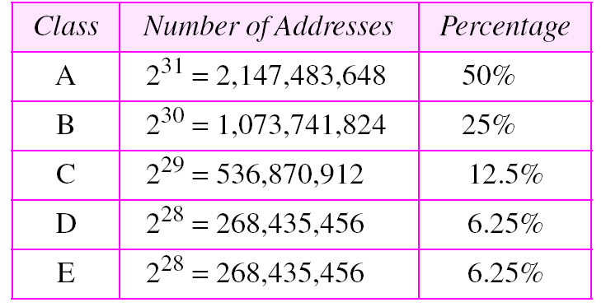
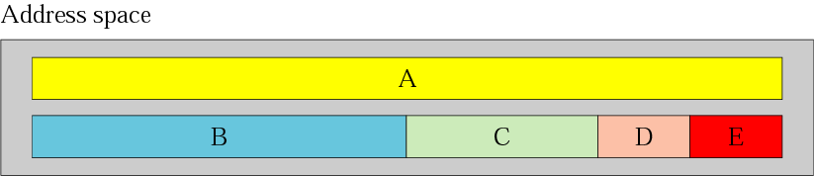
Occupation of the address space

Slide 6
Find the class of each address:
227.12.14.87
193.14.56.22
14.23.120.8
252.5.15.111
134.11.78.56

Slide 7
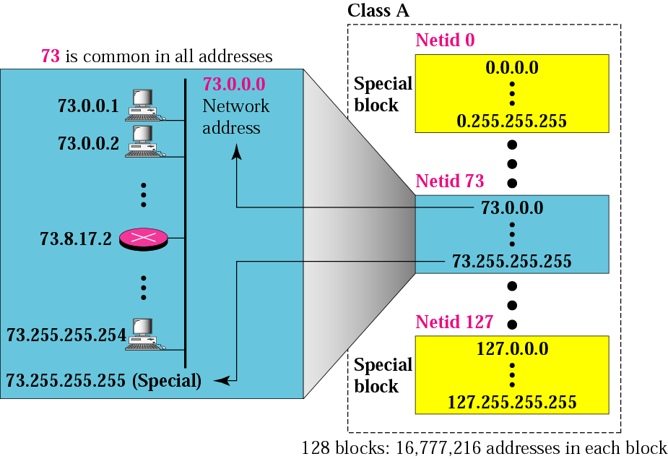
Blocks in class A
10.0.0.0 – 10.255.255.255 is used for private addresses

Slide 8
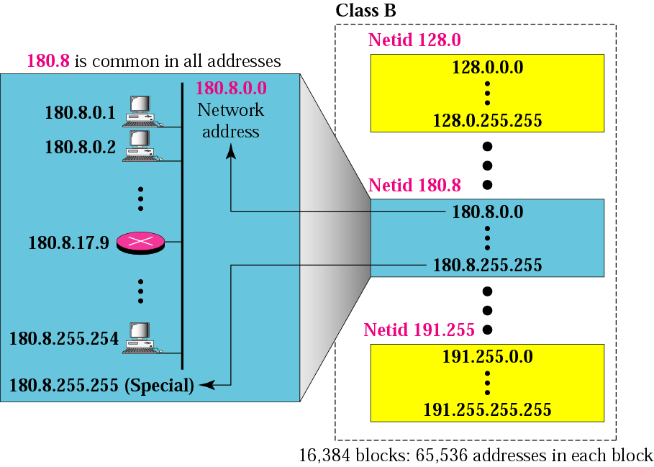
Blocks in class B
Total 16 blocks, 172.16.0.0 – 172.31.255.255 used for private addresses

Slide 9

Blocks in class C
Total 255 blocks, 192.168.0.0 – 192.168.255.255 used for private addresses

Slide 10
Given the network addresses, find the class, the block, and the range of the addresses.
17.0.0.0
132.21.0.0
220.34.76.0

Slide 11
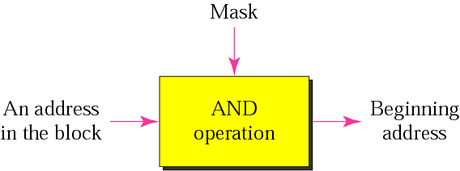
Masking
To find Netid from given address
Ex.
200.45.34.56 11001000 00101101 00100010 00111000
255.255.255.0 11111111 11111111 11111111 00000000
200.45.34.0 11001000 00101101 00100010 00111000

Slide 12
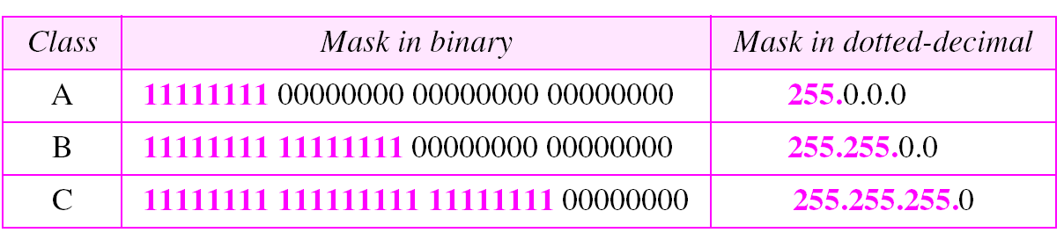
Default masks

Slide 13
Given the addresses, find the beginning address (network address).
23.56.7.91
132.6.17.85
201.180.56.5

Slide 14
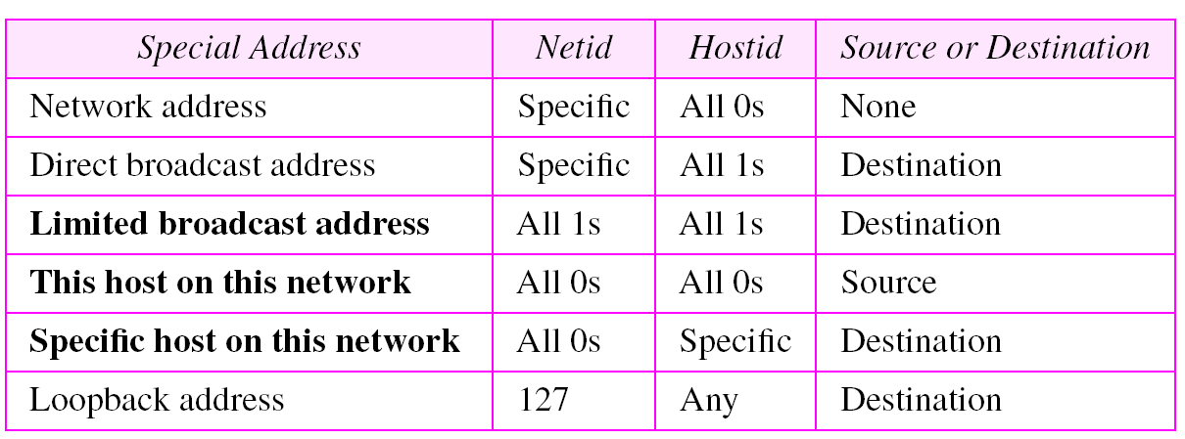
Special addresses

Slide 15
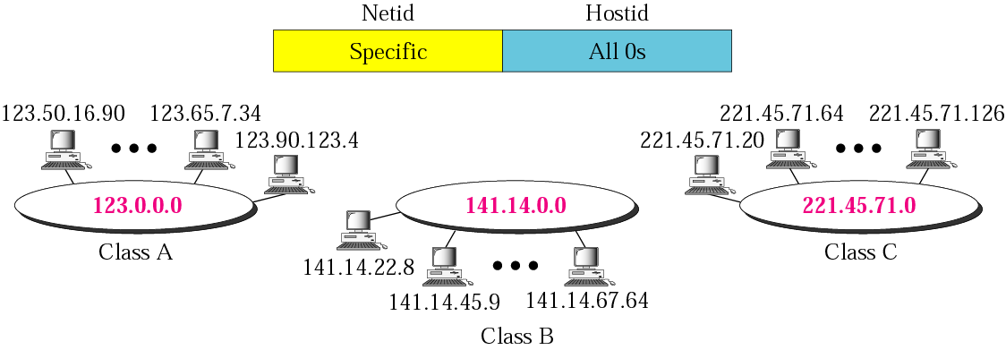
Network address

Slide 16
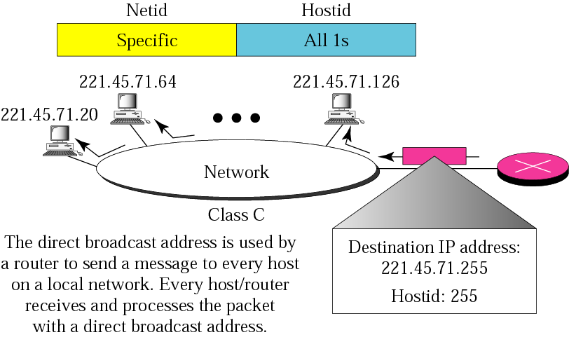
direct broadcast address

Slide 17
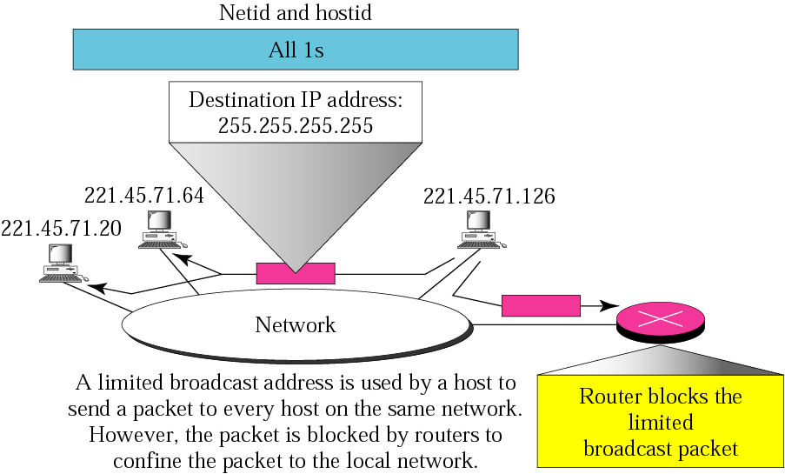
limited broadcast address

Slide 18
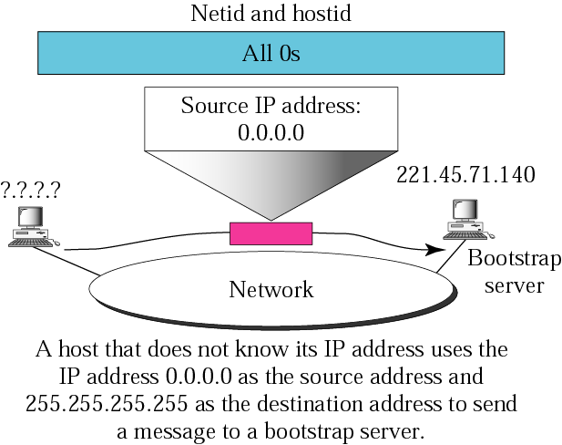
this host on this network

Slide 19
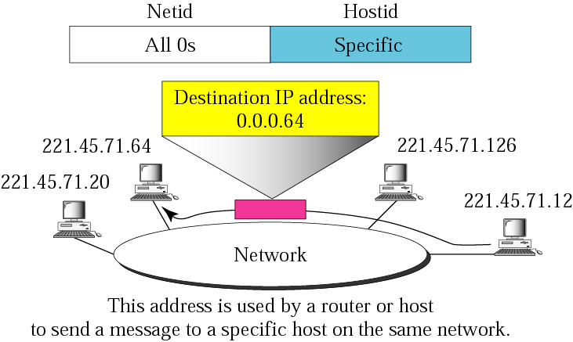
specific host on this network

Slide 20
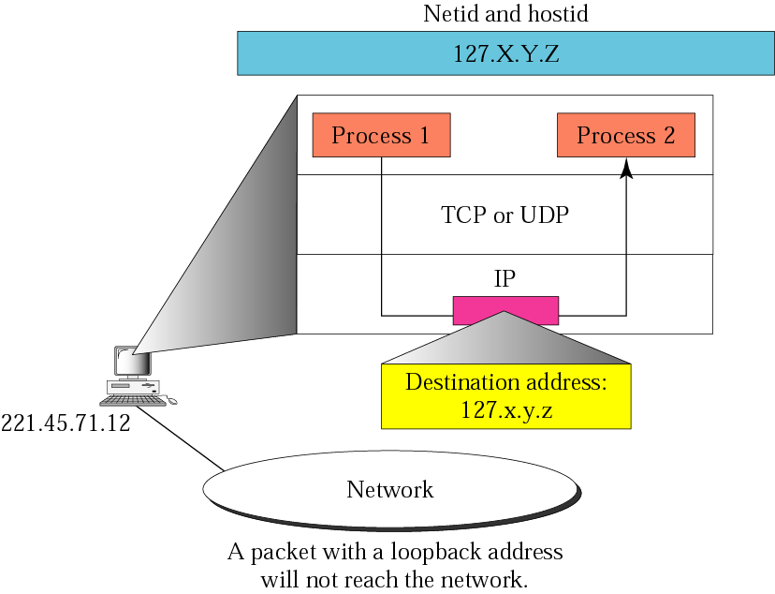
loopback address

Slide 21
SUBNETTING AND SUPERNETTING
The network addresses available for assignment to organizations are close to depletion. This is coupled with the ever-increasing demand for addresses from organizations that want connection to the Internet.
two solutions: subnetting and supernetting.

Slide 22
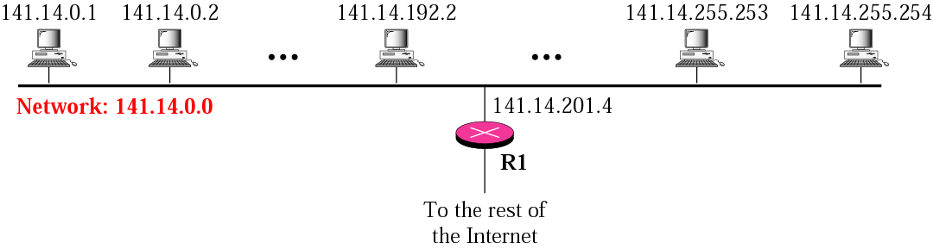
IP addresses are designed with two levels of hierarchy

Slide 23
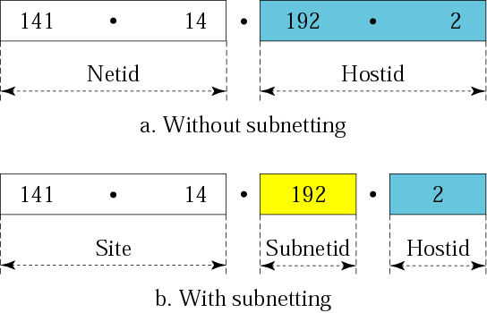
Addresses in a network with and without subnetting

Slide 24
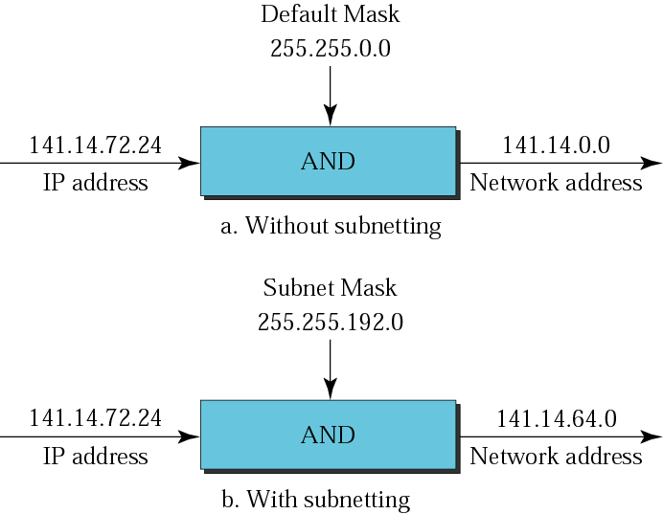
Default mask and subnet mask

Slide 25
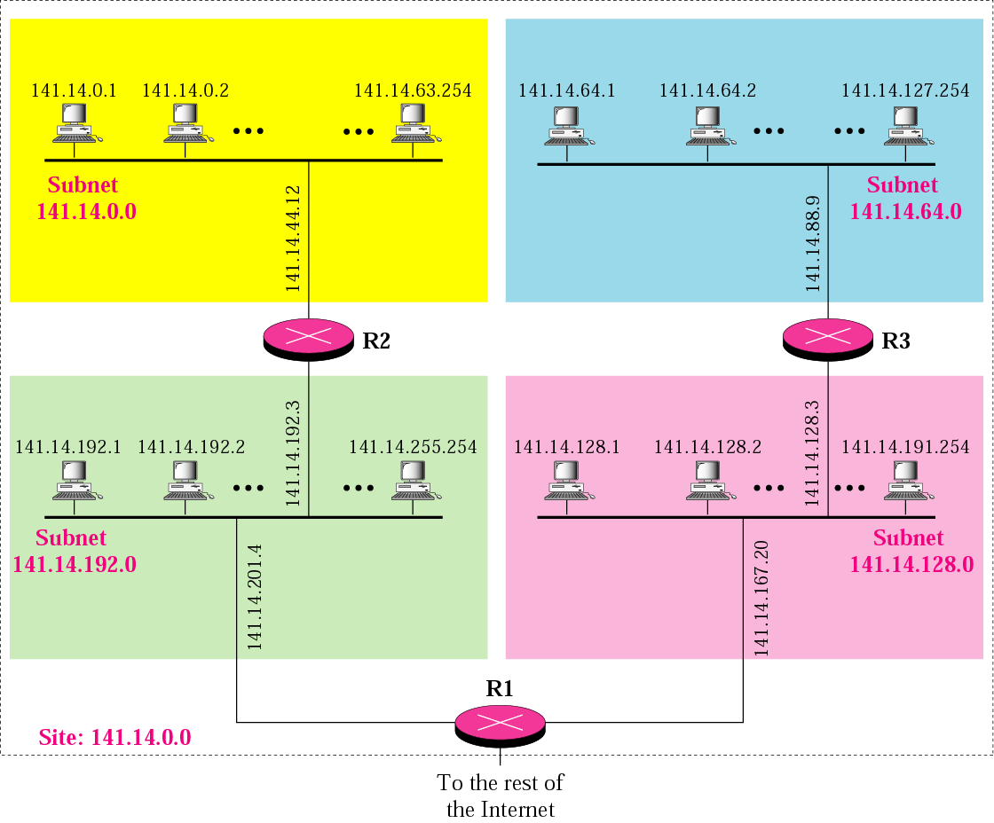

Slide 26
What is the subnetwork address if the destination address is 200.45.34.56 and the subnet mask is 255.255.240.0?
Address ➡ 11001000 00101101 00100010 00111000
Subnet Mask ➡ 11111111 11111111 11110000 00000000
Subnetwork Address ➡ 11001000 00101101 00100000 00000000.

Slide 27
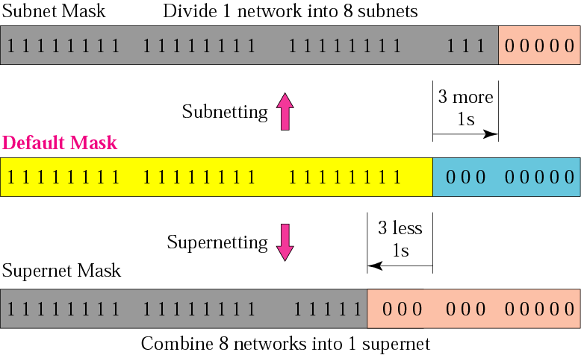
Comparison of subnet, default, and supernet masks

Slide 28
Note:
The idea of subnetting and supernetting of classful addresses is almost obsolete.

Slide 29
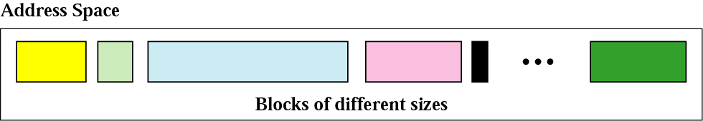
Classless Addressing
In classless addressing variable-length blocks are assigned that belong to no class. In this architecture, the entire address space (2³² addresses) is divided into blocks of different sizes.

Slide 30
Subnetting
When an organization is granted a block of addresses, it can create subnets to meet its needs. The prefix length increases to define the subnet prefix length.
Fixed-Length Subnets
Variable-Length Subnets

Slide 31
Example 1
An organization is granted the block 130.34.12.64/26. Find first address, no of host and last address.
The organization needs 4 subnets. What is the subnet prefix length? What are the subnet addresses and the range of addresses for each subnet.

Slide 32
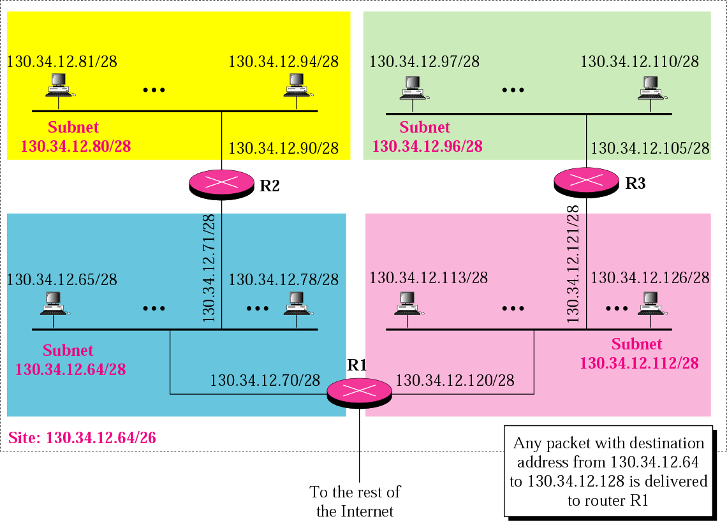

Slide 33
Example 2
An organization is granted a block of addresses with the beginning address 14.24.74.0/24. There are 2³²⁻²⁴= 256 addresses in this block. The organization needs to have 11 subnets as shown below:
a. two subnets, each with 64 addresses.
b. two subnets, each with 32 addresses.
c. three subnets, each with 16 addresses.
d. four subnets, each with 4 addresses.
Design the subnets.

Slide 34
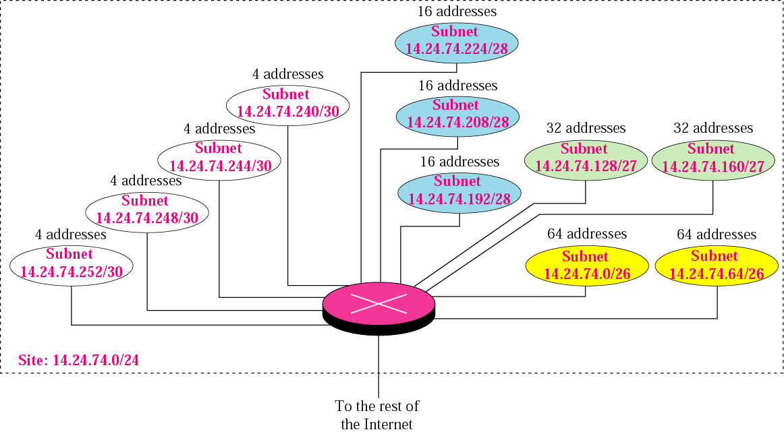

Slide 35
Example 3
An ISP is granted a block of addresses starting with 190.100.0.0/16 (65,536 addresses). The ISP needs to distribute these addresses to three groups of customers as follows:
a. The first group has 64 customers; each needs 256 addresses. b. The second group has 128 customers; each needs 128 addresses c. The third group has 128 customers; each needs 64 addresses.
Design the subblocks and find out how many addresses are still available after these allocations.

